Slide 1


Slide 2
Swachh Bharat Abhiyan (SBA) is a nationwide campaign in India that aims to clean up the country and promote hygiene and sanitation. The relevance of SBA is immense, as it addresses several critical issues:
1. Public Health: Improves sanitation and hygiene, reducing the spread of diseases like diarrhea, cholera, and malaria.
2. Environmental Protection: Reduces pollution, conserves water, and promotes sustainable waste management.
3. Economic Benefits: Creates jobs, stimulates local economies, and increases tourism.
4. Social Impact: Promotes social change, raises awareness, and encourages community participation.

Slide 3
5. Global Recognition: Enhances India's global image and reputation.
6. Rural Development: Focuses on rural areas, where sanitation and hygiene are often neglected.
7. Women's Empowerment: Improves women's health, safety, and dignity by providing access to toilets.
8. Education: Integrates sanitation and hygiene education into school curricula.
9. Community Engagement: Encourages citizen participation, ownership, and accountability.
10. Sustainable Development: Aligns with the United Nations' Sustainable Development Goals (SDGs), particularly Goal 6 (Clean Water and Sanitation).By addressing these critical areas, Swachh Bharat Abhiyan plays a vital role in creating a cleaner, healthier, and more sustainable India.

Slide 4

Introduction to Swachh Bharat
The campaign was officially launched on October 2, 2014, by Prime Minister Narendra Modi, marking the 145th birth anniversary of Mahatma Gandhi.
Swachh Bharat Abhiyan, also known as the Clean India Mission. is a flagship initiative launched by the Government of India with the goal of transforming the country into a clean and hygienic nation.
The choice of this date is symbolic, as Mahatma Gandhi himself was a strong advocate of cleanliness and sanitation, often emphasizing that sanitation is more important than independence.
The primary aim of Swachh Bharat Abhiyan is to address the critical issues of sanitation, waste management, and open defecation, which have been longstanding challenges in India.
Aim is to provide sanitation facility to every family including toilet, solid and liquid waste disposal system, village cleanliness and safe drinking water supply by 2nd october 2019

Slide 5
Background of Swach Bharat Abhiyan
With effect from 1 April 1999, the Government of India instructed the comprehensive rural sanitation program and launched the total sanitation campaigning (TSC) which was later (on 1 April 2012 renamed Nirmal Bharat Abhiyan

Slide 6
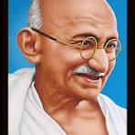
Mahatma Gandhi said
“Sanitation is more important than Independence.
“I will not let anyone walk through my mind with their dirty feet.”

Slide 7
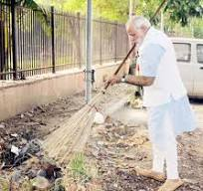
What is the goal of Swach Bharat Abhiyan
By 2019 Gandhi’s 150 birthday anniversary , every city, village, town is to be clean. That is they will have pucca toile for all, safe drinking water , waste disposal system, clean roads and lane

Slide 8
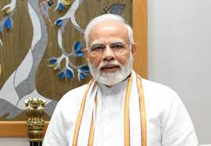
Mission Swachh Bharat
I appeal to every citizen to dedicate 100 hour a year towards clealiness.

Slide 9

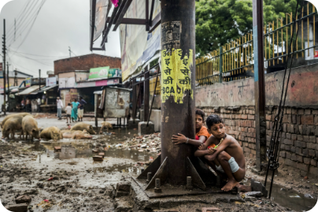
Objectives of the Swachh Bharat Mission
1
Eliminate Open Defecation
2
Promote Solid Waste Management
This goal aims to provide access to toilets for all citizens, particularly in rural areas, and to encourage people to use them.
The mission seeks to improve waste collection, segregation, and disposal practices across India, emphasizing recycling and composting.
3
Increase Public Awareness
4
Behavioral Changes
This goal involves educating the public about sanitation and hygiene through various campaigns and programs.
Encouraging citizens to adopt better sanitation practices and take responsibility for keeping their surroundings clean.

Slide 10
Money sanction for Swachh Bharat Abhiyan
Swachh Bharat Abhiyan is expected to cost over 620 billion. The Government provides an incentive over 15000 for each toilet constructed by a BPL family.
An amount of Rs 90 billion was allocate for the mission in the 2016 Union Budget of India

Slide 11
Objectives of Swachh Bharat Abhiyan
To make India clean through behavioural change.
To promote idea of smart city. A city needs to be clean before it becomes smart.
To eliminate the burdan of communicable disease which India has like Malaria, Diarrhea, Cholera.
To emphasize on the fact that clean mind and body reside in clean environment.
To effectively and efficiently handle waste generated. People are encouraged to separate wet and dry waste for this.

Slide 12

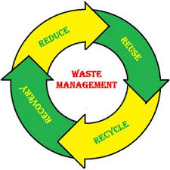
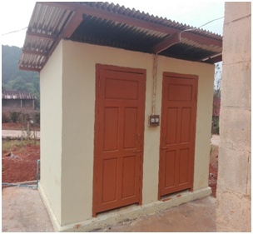
Key Components of the Swachh Bharat Mission
Construction of Toilets
Waste Management Systems
The mission focuses on constructing toilets in rural areas, particularly for marginalized communities, to ensure access to sanitation.
This includes improving waste collection, segregation, and disposal methods, including recycling and composting, to reduce pollution and promote resource recovery.
Public Awareness Campaigns
Community Mobilization
These campaigns aim to educate citizens about the importance of hygiene, sanitation, and responsible waste disposal practices.
The mission encourages the active participation of communities in maintaining cleanliness and implementing sanitation initiatives in their areas.

Slide 13

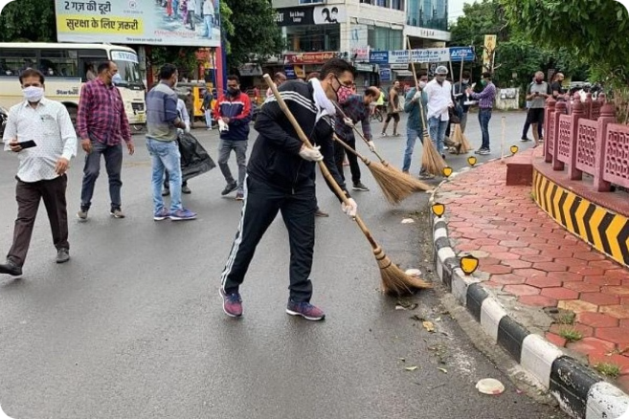
Achievements and Progress of the Swachh Bharat Mission
1
Phase 1 (2014-2019)
Significant progress was made in constructing toilets, with millions built in rural areas. Open defecation rates declined drastically.
2
Phase 2 (2019-2024)
Focus shifted to maintaining the sanitation facilities built in Phase 1, promoting source segregation of waste, and expanding awareness campaigns.
3
Phase 3 (2024 onwards)
This phase emphasizes sustainability, promoting circular economy principles, and improving waste management technologies.

Slide 14
Challenges Faced in Implementing the Swachh Bharat Mission
Financial Constraints
Behavioral Change
Infrastructure Gaps
Securing adequate funding for constructing and maintaining sanitation facilities, particularly in rural areas, remains a challenge.
Changing long-standing habits and encouraging people to use toilets and dispose of waste responsibly is a major challenge.
A lack of proper waste collection and disposal systems, especially in urban areas, hampers the mission's effectiveness.

Slide 15

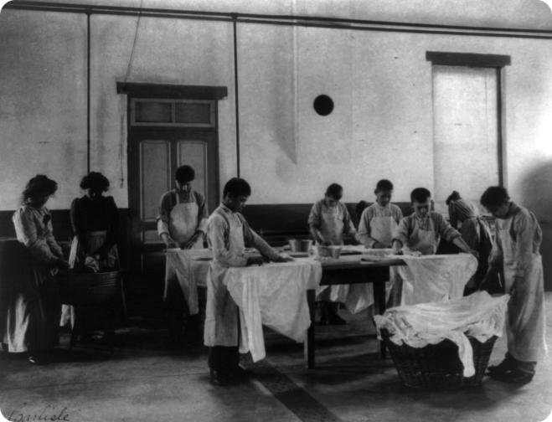



Role of Government, Citizens, and Organizations in the Swachh Bharat Mission
Government
Plays a crucial role in policy formulation, funding, and providing infrastructure for sanitation and waste management.
Citizens
Have a responsibility to use toilets, dispose of waste responsibly, and participate in community cleanliness initiatives.
Organizations
Can contribute through awareness campaigns, community mobilization efforts, and providing technical expertise in sanitation and waste management.

Slide 16

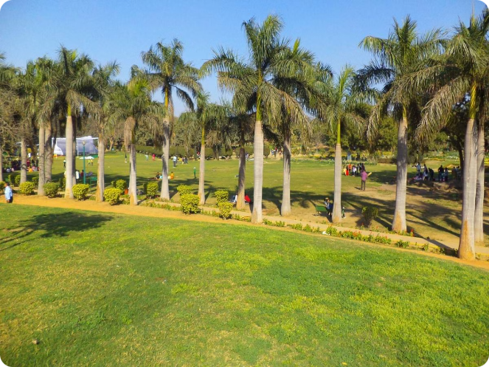




Future Plans and Sustainability of the Swachh Bharat Mission
Promote Circular Economy
Strengthen Community Engagement
Focus on resource recovery and recycling to minimize waste generation and promote sustainable practices.
Encourage community ownership and participation in maintaining cleanliness and sanitation initiatives.
Embrace Technology
Ensure Long-Term Sustainability
Utilize technology for efficient waste management, monitoring sanitation facilities, and promoting awareness campaigns.
Develop robust systems for waste management, sanitation, and infrastructure to ensure long-term sustainability.

Slide 17
Modi selected 7 notable public figure
Kapil Sharma – famous comedian and notable television personality.
Padmanabha Acharya – A politician and former governor of Nagaland.
Sonal Mansingh – Indian classical dancer and Member of Parliament from Rajya Sabha.
Sourav Ganguly – Eminent cricket personality.
Aroon Purie – Indian businessman and founder and editor-in-chief of India Today.
Kiran Bedi – Retired Indian Police Services officer who is presently serving as the Lieutenant Governor of Puducherry.
Cherukuri Ramoji Rao – Indian businessman, educationist, film producer and media entrepreneur.

Slide 18
Top 10 cleanest city of India (2016 survey)
Indore (Madhya Pradesh)
Surat (Gujrat)
Navi Mumbai (Maharashtra)
Ambikapur (Chattisgarh)
Mysore (Karnataka)
Vijaywada (Andhrapradesh)
Ahemdabad (Gujrat)
New Delhi, Delhi
Chandrapur (Maharashtra)
Khargone (Madhya Pradesh)

Slide 19
Swachh Bharat Abhiyan: HIT OR MISS’
Target: 100000 community toilets by 2019
25000 toilets were insatlled
Success rate-25%
Taget: 25 lakh individual toilets by 2019
4.6 lakh installed successfully and 12 lakh were under process
Success rate-18%
Target: 1000 cities with 100% solid waste management by 2019
Only 2 have achieved
Success rate-2%

Slide 20


